Slide 1


Name: I. Siva Venkata Bhanu prakash Skills Build Email – ID: irakamsivabhanuprakash@gmail.com College name: JNTUA College of engineering, pulivendula Internship domain: ai & ml (03 – 06 – 2024 to 15 – 07 – 2024)

Slide 2
PROJECT TITLE/Problem Statement
Project Title: Employee Burnout Prediction
Problem Statement:
Developing a machine learning model to predict employee burnout based on various factors such as work patterns, performance metrics, and employee feedback is essential for enabling early identification of at-risk employees and improving organizational support systems.

Slide 3
AGENDA
Phase | Activities
Initialization | Define goals, plan and resources
Data Collection | Gather data on work patterns and feed back
Data Preparation | Clean data and features
Model Deployment | Train and evaluate machine learning models
Deployment | Develop and deploy a prototype tool
Documentation | Analyze results and document findings
Review | Review outcomes and close the project

Slide 4
PROJECT OVERVIEW
Objective: Develop a machine learning model to predict employee burnout and enhance organizational support systems.
Key Phases:
Initialization: Define goals, scope, resources, and timeline.
Data Collection: Gather data on work patterns, performance, and feedback.
Data Preparation: Clean, preprocess data, and select features.
Model Development: Train and evaluate machine learning models.
Deployment: Develop and test a prototype tool for HR use.
Documentation: Analyze results, provide insights, and document findings.
Review and Closure: Review outcomes with stakeholders and reflect on lessons learned.
Timeline: Approximately 6 weeks
Expected Outcome: A predictive model to identify burnout risks, improving workplace well-being and productivity.

Slide 5
WHO ARE THE END USERS of this project?
HR Professionals
Managers and Team Leaders
Organizational Leadership
Employee Assistance Programs (EAP)
Coordinators

Slide 6
YOUR SOLUTION AND ITS VALUE PROPOSITION
My Solution:
A Machine Learning Model for Predicting Employee Burnout
Value Proposition:
Early Identification of Burnout Risks
Improved Employee Support
Enhanced Workplace Well-being
Data-Driven Decision Making
Efficient Resource Allocation

Slide 7
How did you customize the project and make it your own
1. Adapted Kaggle Dataset
Customized Data: Selected and adapted the Kaggle dataset to fit the specific needs of the organization, focusing on relevant features.
2. Selected Relevant Features
Feature Engineering: Identified key features from the dataset that address burnout issues, such as work hours and job satisfaction.
3. Developed the Machine Learning Model
Algorithm Selection: Chose and fine-tuned machine learning models for predicting burnout based on the dataset’s structure and goals.

Slide 8
MODELLING
Model Training
Models:
Linear Regression
Decision Tree Regression
Random Forest Regression
Training Data:
Fit each model using training data to learn patterns.
Model Evaluation
Metrics:
Root Mean Squared Error (RMSE)
R-squared (R2R^2R2)
Mean Absolute Error (MAE)
Mean Squared Error (MSE)
Evaluation:
Compare model predictions to actual burnout levels.

Slide 9
Key High lights
Linear Regression:
Simple model, easy to interpret.
Assumes linear relationship between features and target.
Decision Tree Regression:
Captures non-linear relationships.
Prone to overfitting.
Random Forest Regression:
Ensemble method, reduces overfitting.
Aggregates predictions from multiple trees.

Slide 10
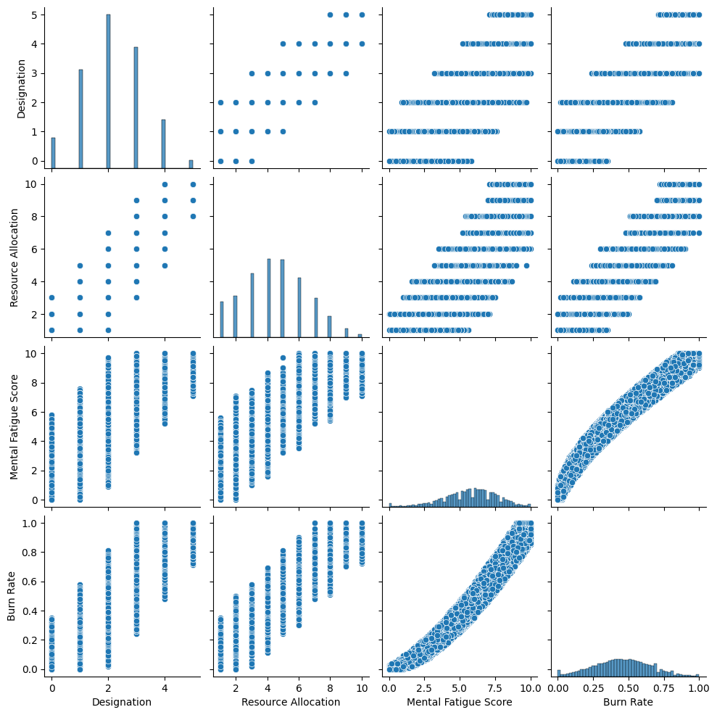
VISUALS

Slide 11
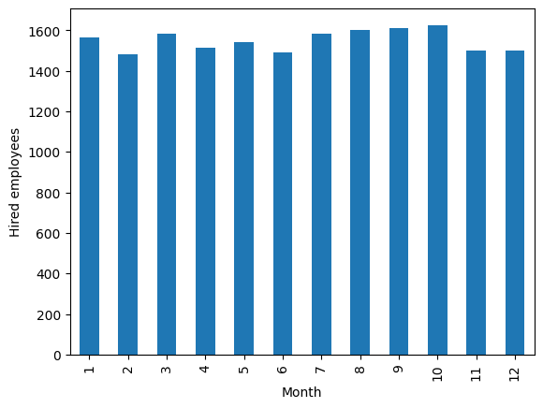
Visuals

Slide 12
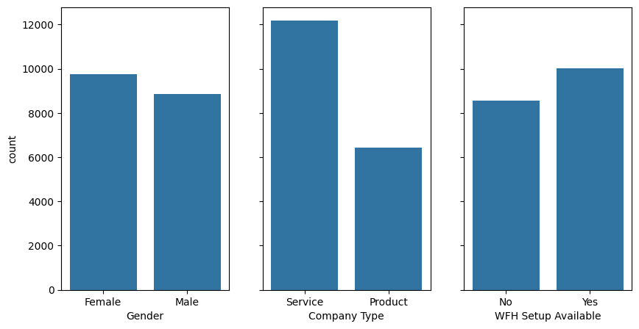
Visuals

Slide 13
Results
Model | RMSE | R^2 | MAE | MSE
Linear Regression | 0.0561 | 0.9188 | 0.0459 | 0.0031
Decision Tree | 0.0484 | 0.900 | 0.0484 | 0.0038
Random Forest | 0.0581 | 0.9130 | 0.0459 | 0.0033

Slide 14
links
Project Github Link:
https://github.com/hynko431/employment_burnout_analysis
https://www.kaggle.com/datasets/vijaysubhashp/employee-burnout-prediction/data

